Slide 1

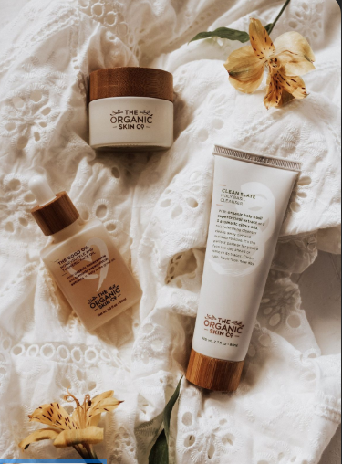
Eyai
Cyndiket
SENTIMENT ANALYSIS OF SKIN CARE PRODUCTS

Slide 2
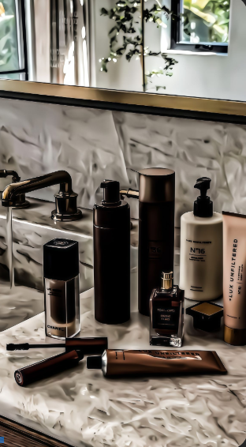
Members
LIONEL AJELITI
STANLEY MACHARIA
TABBY MIRARA
KAVATA MUSYOKA
AMOS KIPKOECH

Slide 3
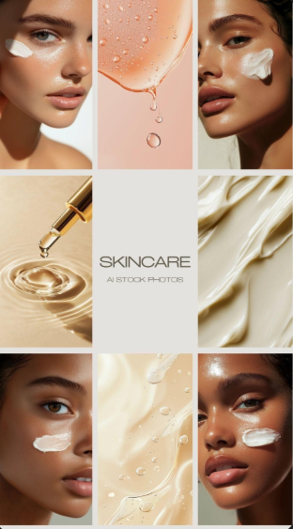

Business Problem
In the beauty and skincare market, user evaluations are a valuable yet underutilized source of consumer information. These evaluations frequently include comprehensive personal experiences with products, emphasizing their impact on different skin kinds, tones, and conditions. However, due to the unstructured and subjective nature of this data, companies, researchers, and potential customers find it challenging to properly assess sentiment or establish trends across enormous amounts of input.

Slide 4
Objectives
Main Objective: To perform sentiment analysis on customer reviews on products to enhance customer satisfaction.
To assess product categories and brand popularity to guide companies on future pricing
To assess the price range across various products to improve the affordability of products for customers.
To detect common keywords and phrases to highlight positive, neutral, and negative reviews on products to understand customer satisfaction and dissatisfaction.
To build a model that recommends products based on skin type, skin tone and price.

Slide 5
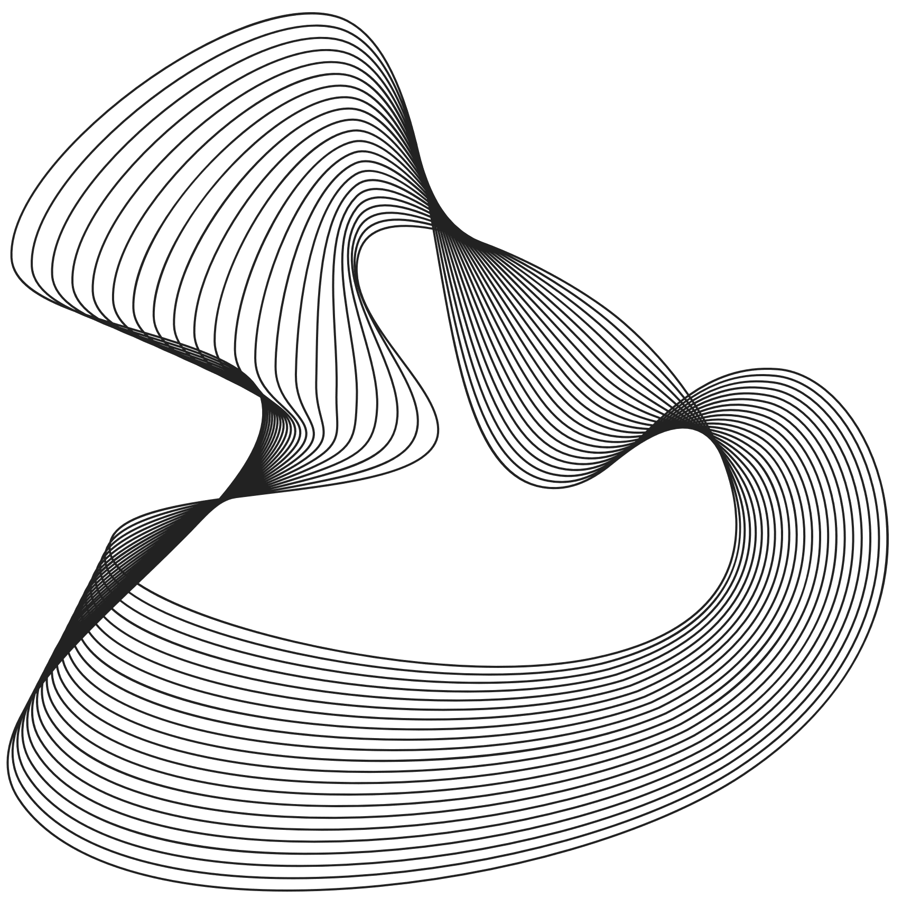
Stakeholders
Online stores that sell skin care products.
Companies that produce and sell skin care products.
Customers

Slide 6
Data understanding
The data was taken from Kaggle It contains information about beauty products from Sephora online store. It had 285412 rows and 19 columns, and some columns had missing values.
The following are the key features for the dataset:
Rating
Is recommended
Total feedback count
Total negative feedback count
Total positive feedback count
Review text
Review title
Skin tone
Skin type
Price
Returns
Diversification
Portfolio
Preservation

Slide 7
Exploratory Data Analysis
Exploratory Data Analysis (EDA) helps you understand the structure, quality, and patterns within a dataset before modeling.

Slide 8

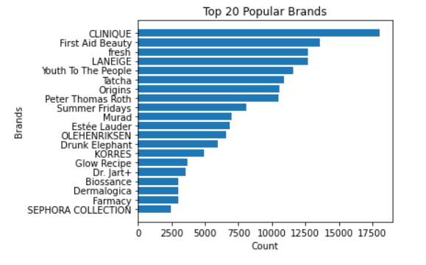
Popular Brands
CLINIQUE was the most popular in the dataset, at around 63% and SEPHORA COLLECTION was the least, at 8%.

Slide 9
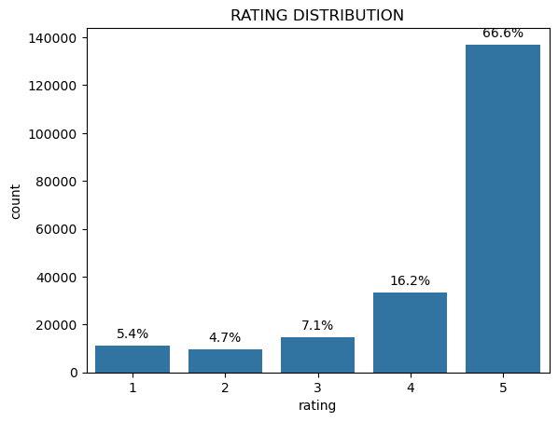
Rating Distribution
About 67% of products were rated at 5, while about 6% were rated 1.

Slide 10
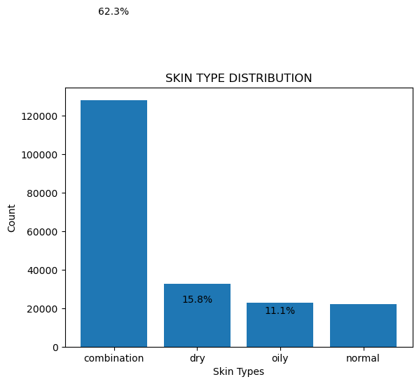
Skin Types Distribution
About 62% of the customers had combination of oily and dry skin, while around 16% had dry, 11%, oily, and 10%, normal.

Slide 11
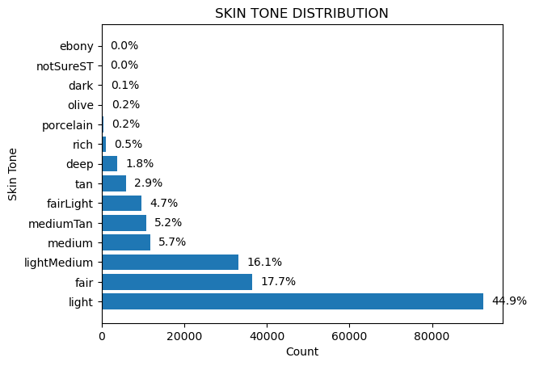
Skin Tone Distribution
Approximately 45% of the customers have light skin tone.

Slide 12
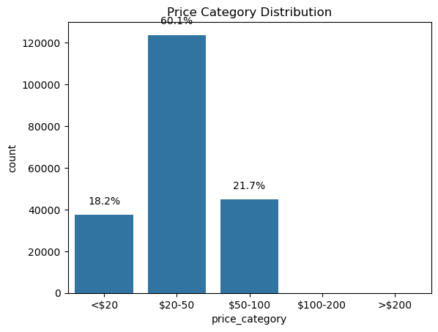
Price Category Distribution
About 60% of products range between 20-50 dollars. This shows a big percentage of products are affordable

Slide 13
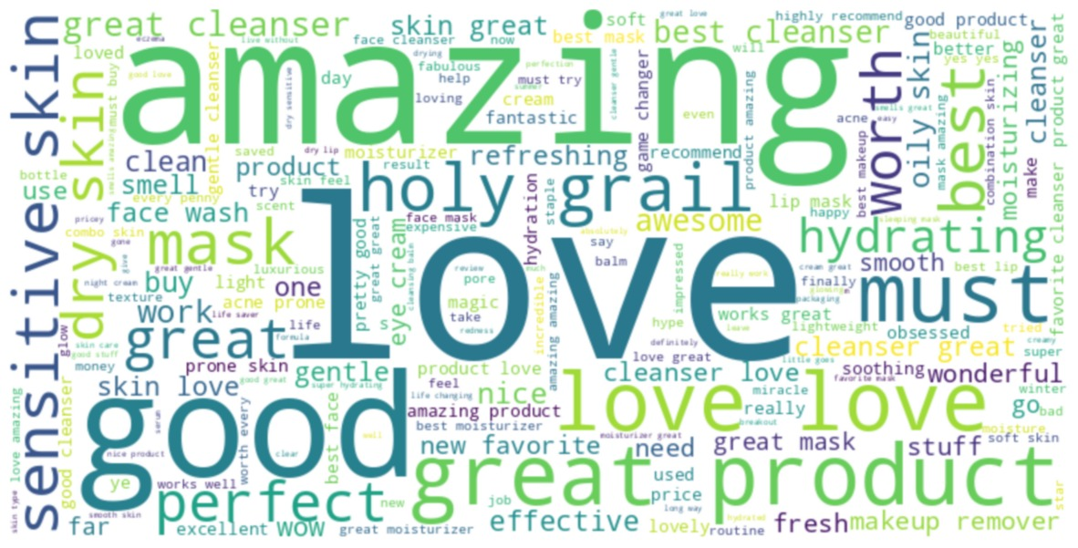
WordCloud for Positive Sentiments
Words like “Amazing,” “Love,” “Great,” and “Good” stand out.

Slide 14
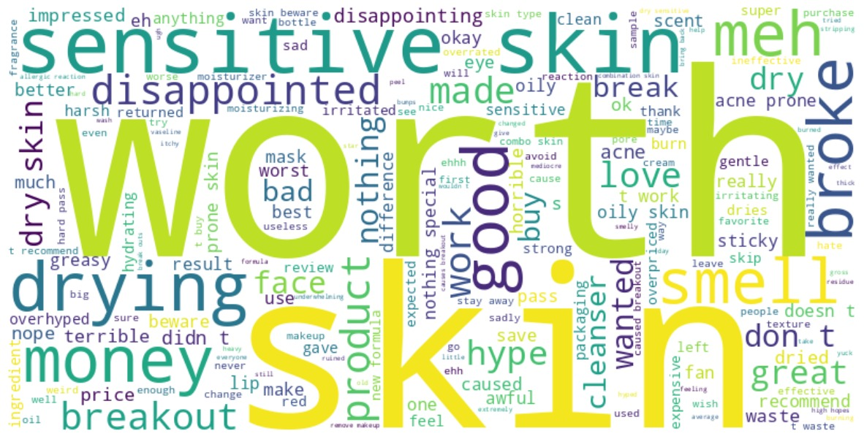
WordCloud for Negative Sentiments
Words like “worth,” “skin,” “sensitive,” “drying,” and “money” .

Slide 15
Modeling
Model | Accuracy | F1-Score | AUC
Logistic Regression | 0.95 | 0.87 | 0.98
Linear SVC | 0.95 | 0.87 | 0.98
Random Forest | 0.96 | 0.90 | 0.98
XG BOOST | 0.96 | 0.91 | 0.99
Accuracy - Shows how often the model is correct overall.
F1-Score - Shows how well the model balances being right when it says something is true and not missing important cases.
AUC - Area Under The Curve
Returns

Slide 16

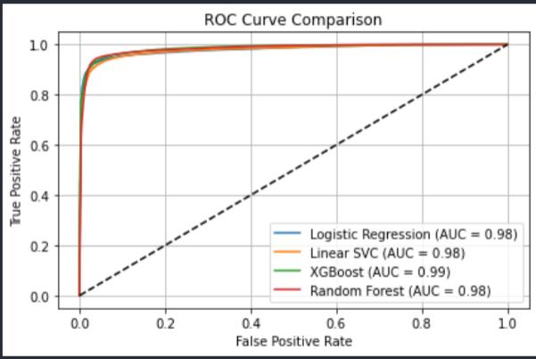
Model Evaluation
From the diagram, XGBOOST has the highest AUC of 0.99 thus has the best classification performance while the other models have 0.98 showing strong classification power but XGBOOST is the best model.

Slide 17
Conclusion
We picked XGBOOST because it was the best performing model for its excellent classification power as it provides the most accurate trade-off between sensitivity (recall) and specificity.
Returns

Slide 18
Recommendations
We recommend:
Personalized Product Displays for online stores.
DEI(Diversity, Equity, and Inclusion) Transparency for companies.
Promotional Targeting for online stores.
Generate educational content for customers on the range and pricing of products
Product use.
Returns

Slide 19
Thank You
Gerente General

